Slide 1
Group 13
Haoyu Sun Yiwei Zhang

Slide 2
Purpose
Find the most popular elements in Halifax
---- Food, music, mall, viewpoint
Compare their performance in different seasons
----winter, summer
Predict future trends

Slide 3

Data extraction and analysis
All of the data comes from twitter. We extract the useful historical comments which related to elements and Halifax in recently five years.
Through analysis, we could know the state of each sentence is neutral, negative or positive, and finally integrate all the comments to get the score of one element.
Satisfied score:
$$\frac{positive}{\begin{aligned}positive+negative+netural \\ \end{aligned}}$$

Slide 4
Data tools
Data gathering tweepy
Data cleaning: python
Data analysis: sentiment analysis
Visualization: tableau

Slide 5
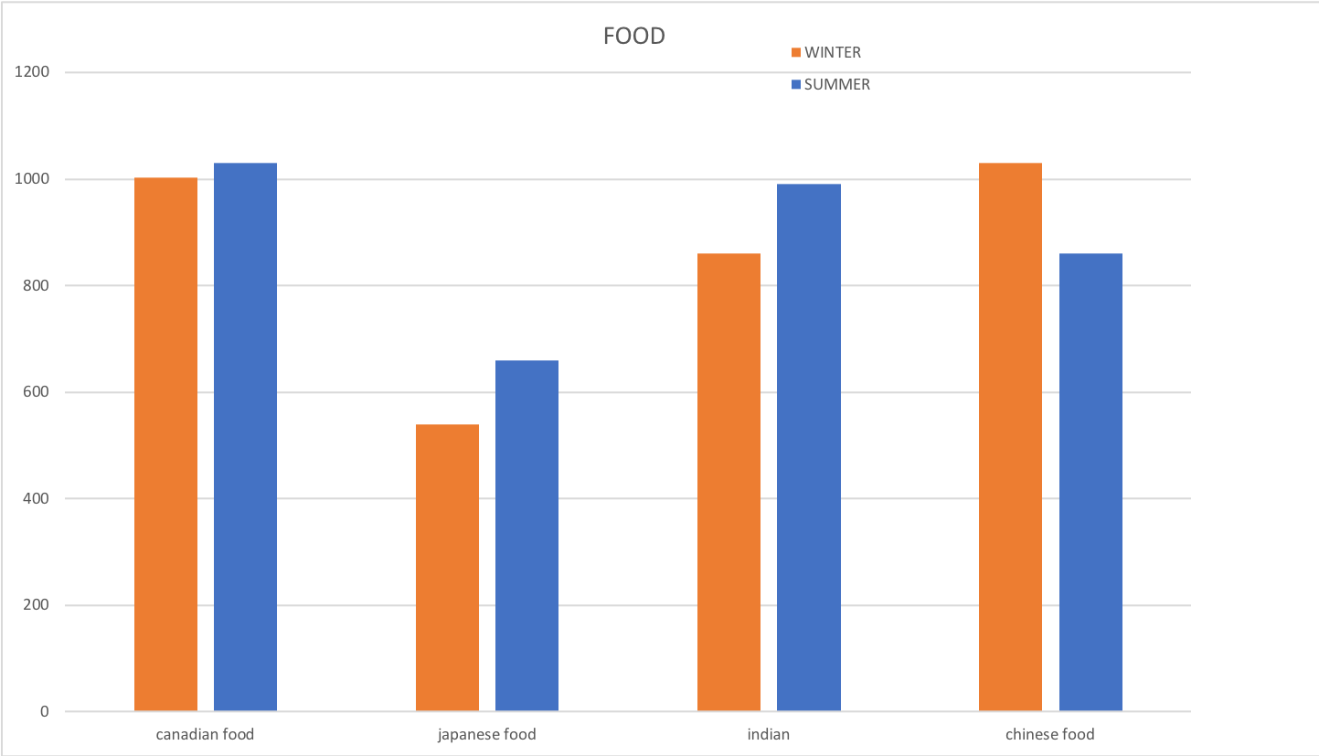

Slide 6
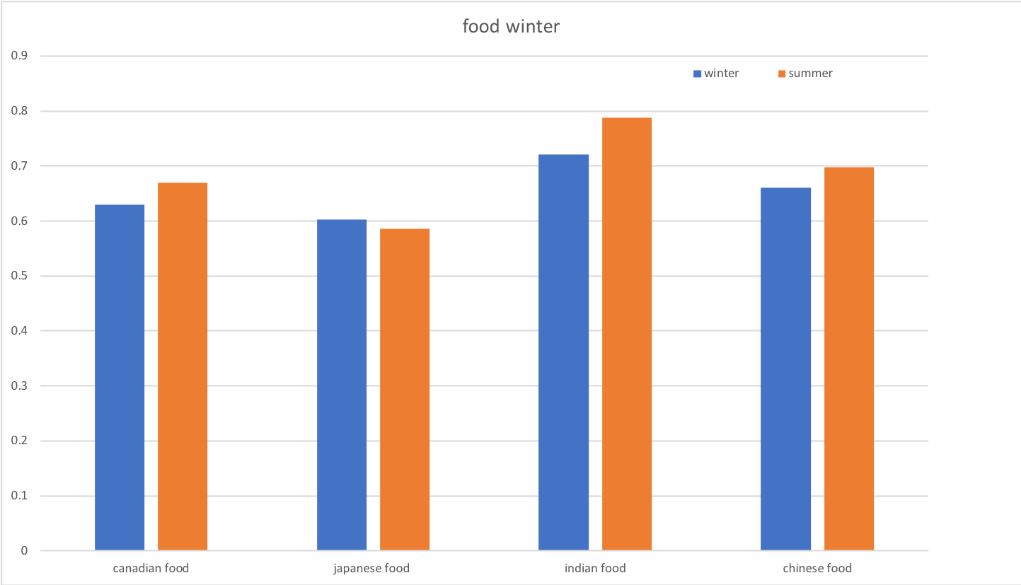

Slide 7
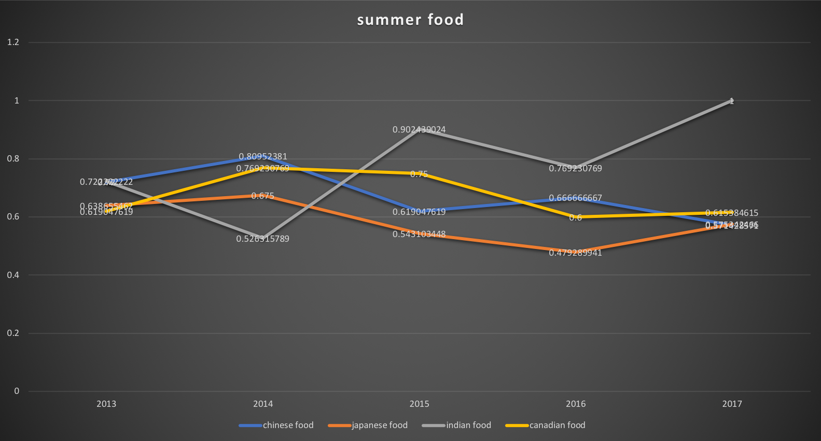

Slide 8
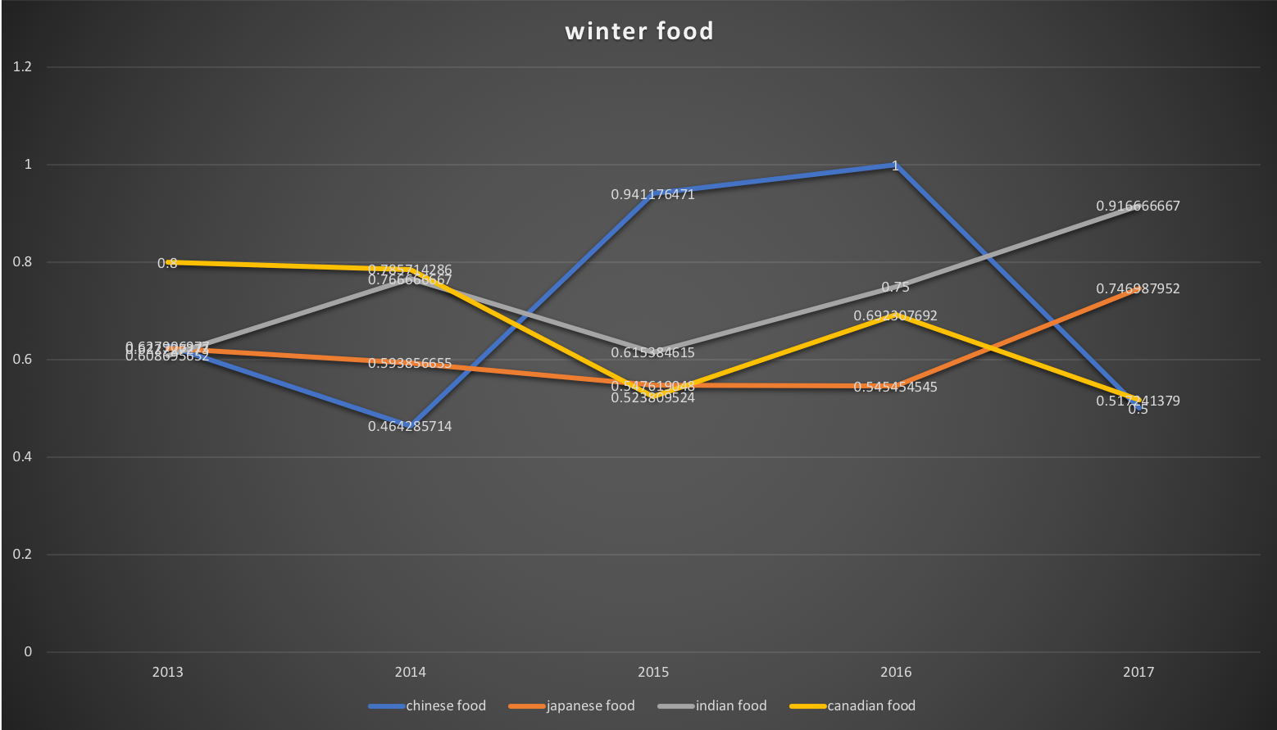

Slide 9
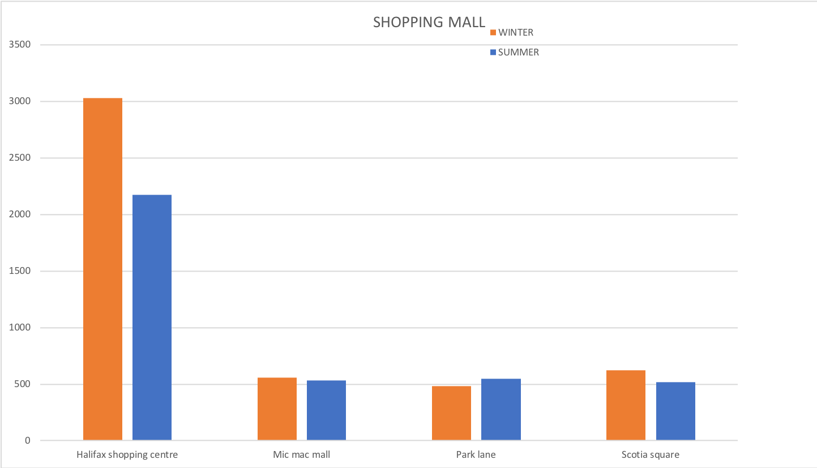

Slide 10
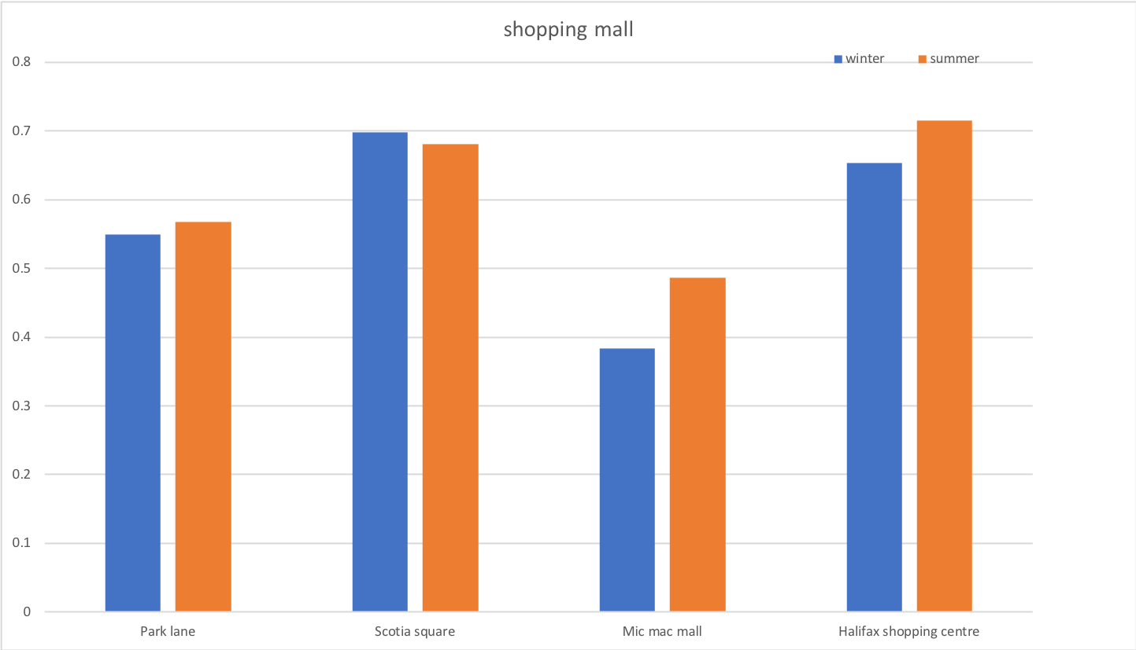

Slide 11
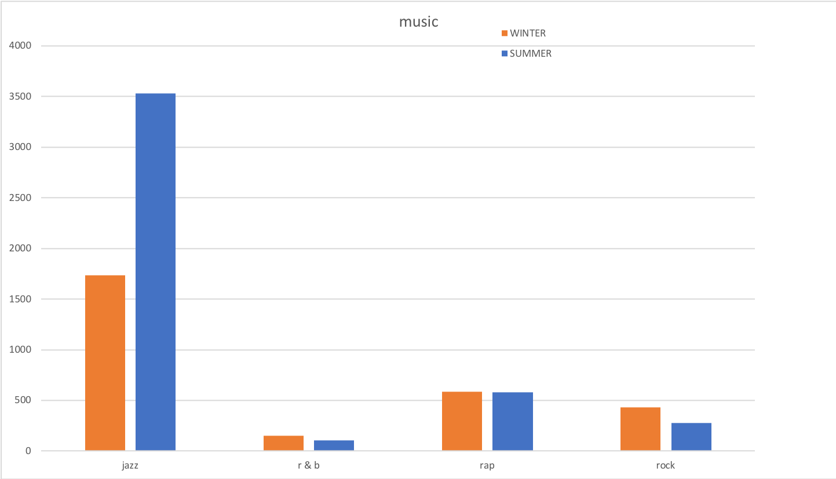

Slide 12
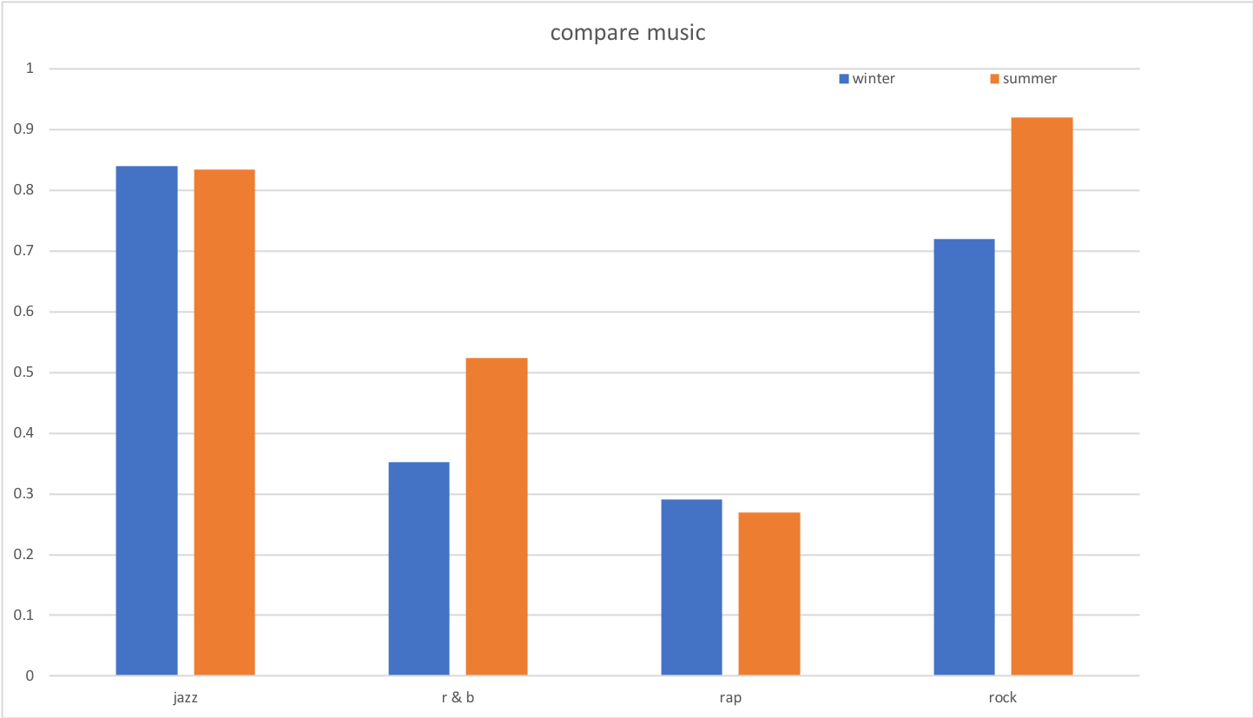

Slide 13
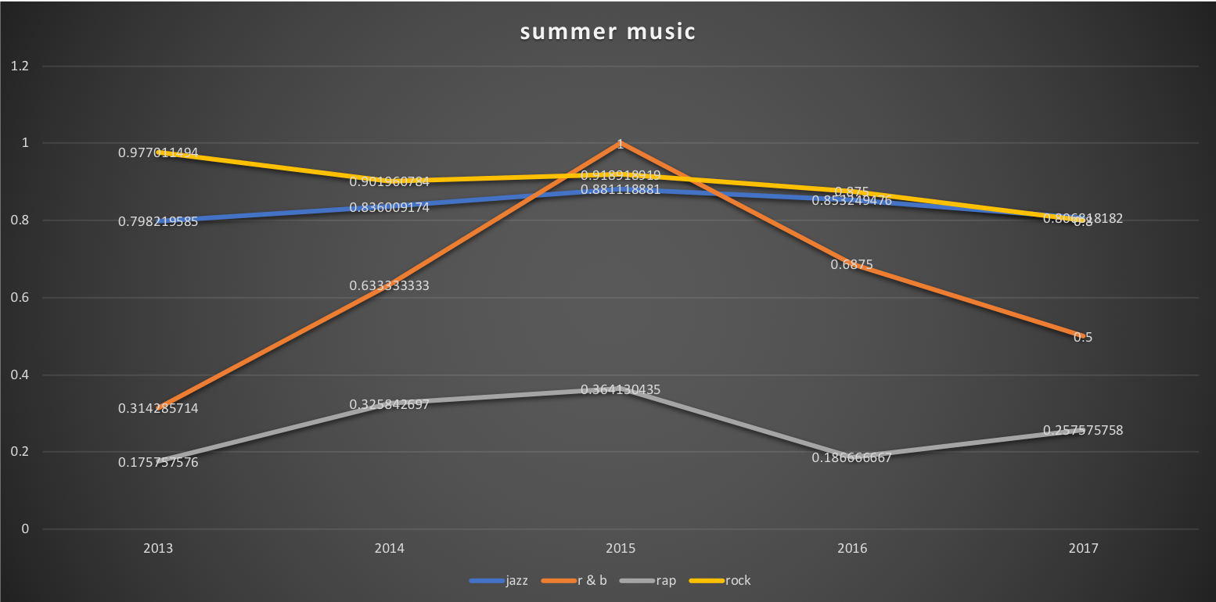

Slide 14
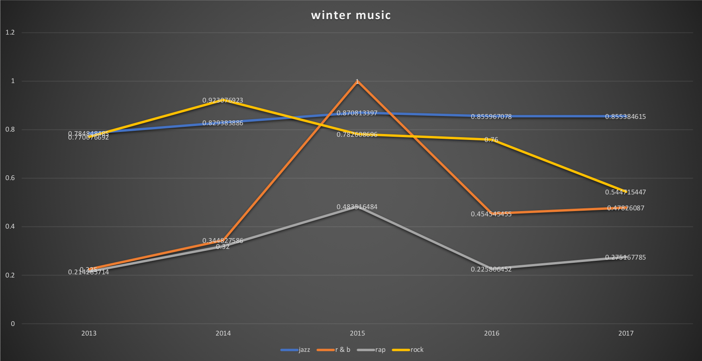

Slide 15
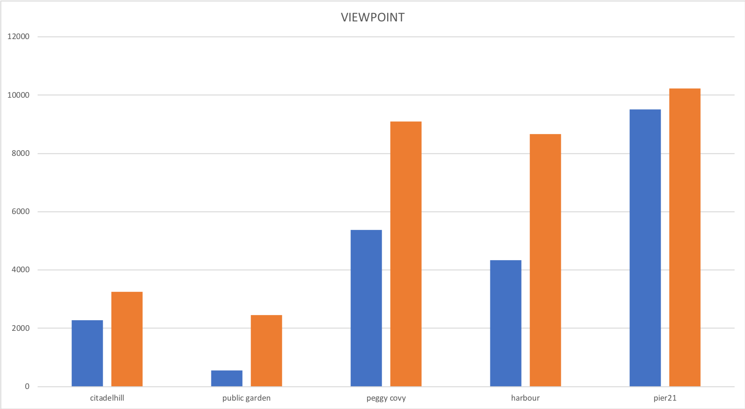

Slide 16
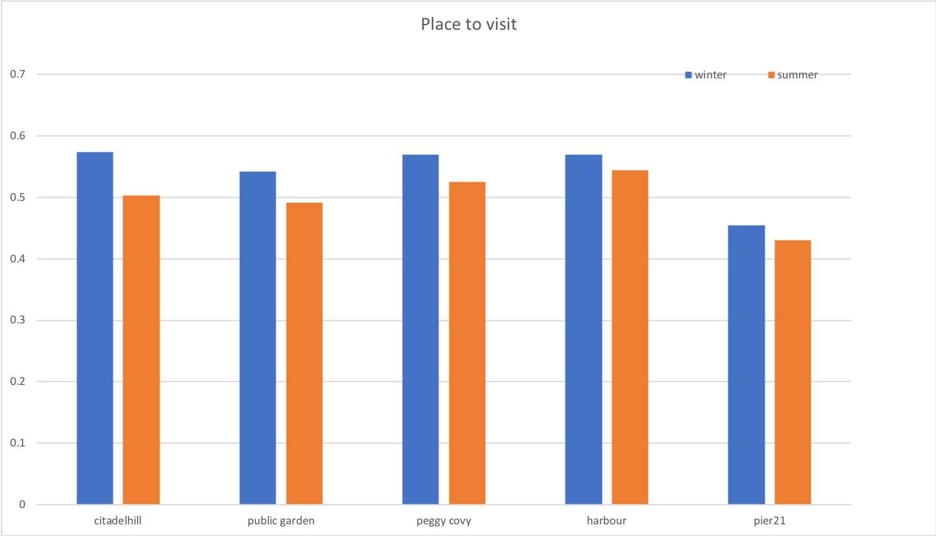

Slide 17
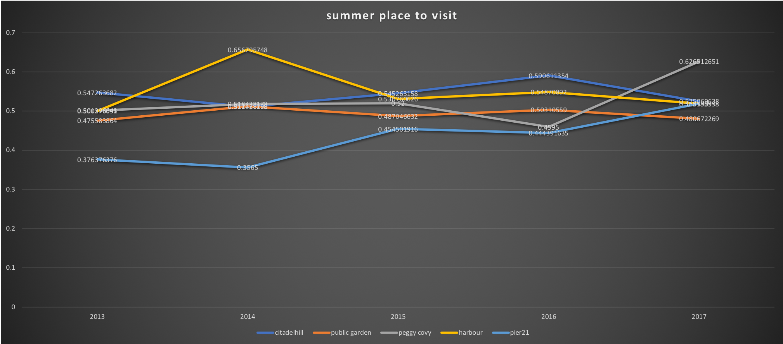

Slide 18
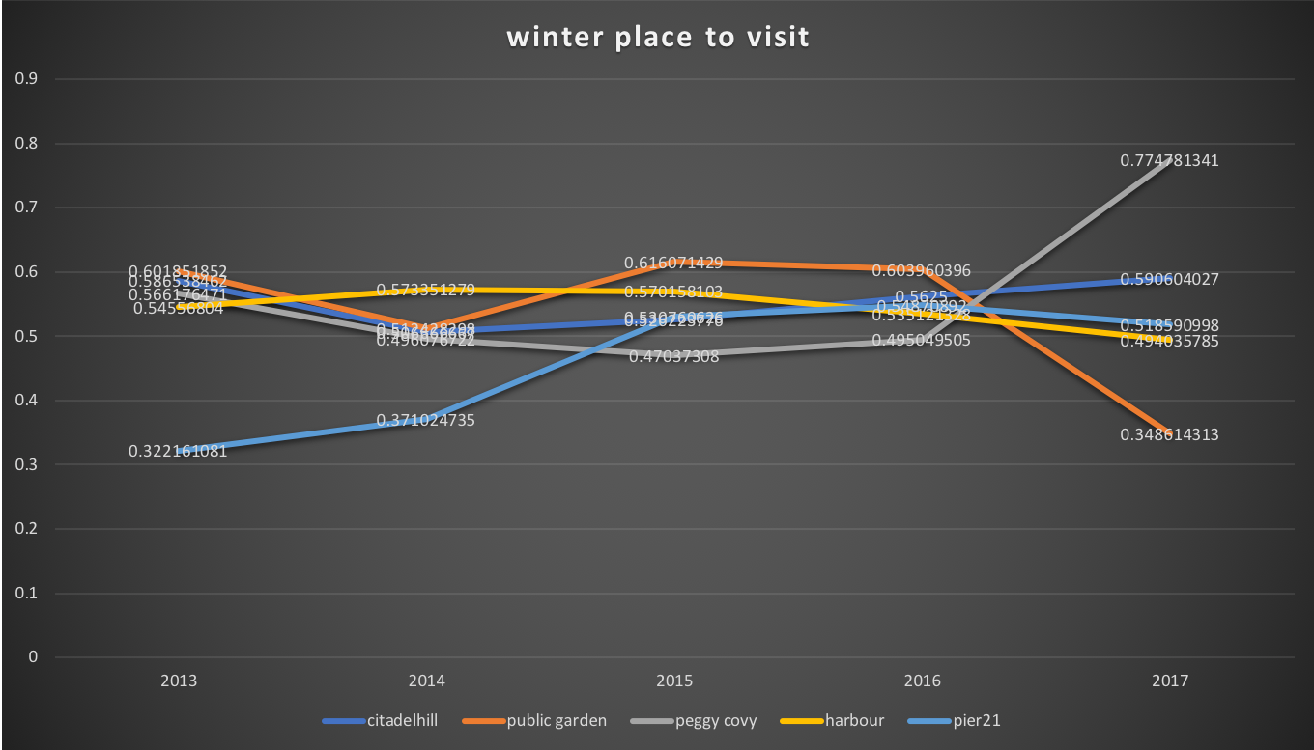

Slide 19
Direction of Data application
Give appropriate advice and opportunities to entrepreneurs
For tourists and residents, they can have a better reference direction
Help the communities to organize better events
Help residents to explore more things to do in leisure time

